Slide 1
Classification
with Decision Trees & Nearest Neighbors
Ilya Chugunov
Princeton AI4ALL
Slides adapted from: Maddie Bland / Wells Lucas Santo / Judy Du (AI4ALL)

Slide 2
Recap
Supervised Learning:

Slide 3
Recap
Supervised Learning: learning from labelled examples

Slide 4
Recap
Supervised Learning: learning from labelled examples
Classification:

Slide 5
Recap
Supervised Learning: learning from labelled examples
Classification: determining what class each new example belongs to

Slide 6
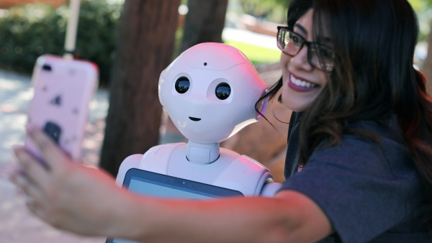
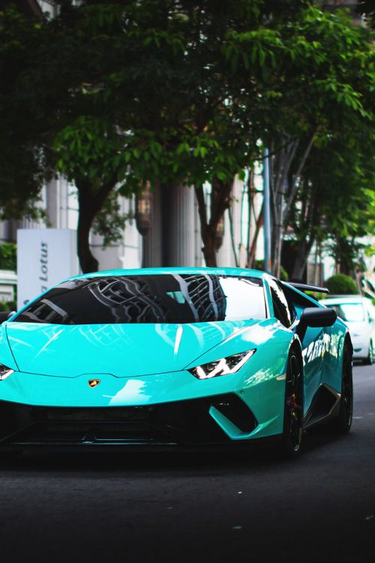
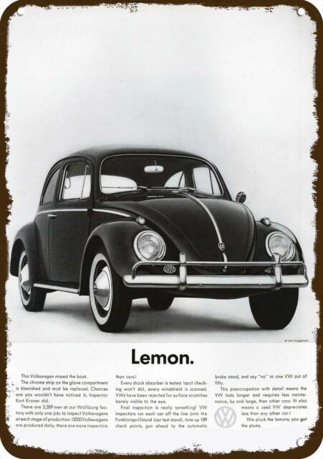
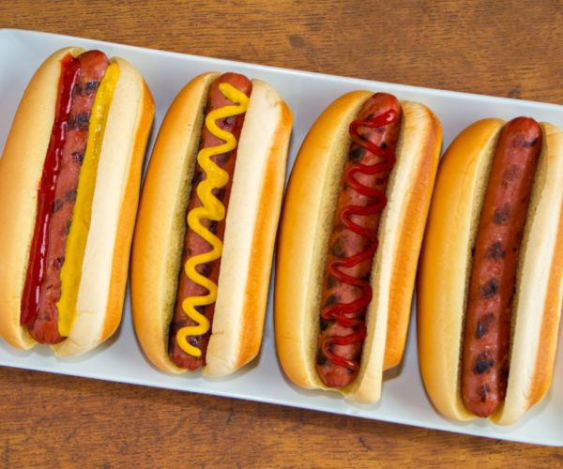
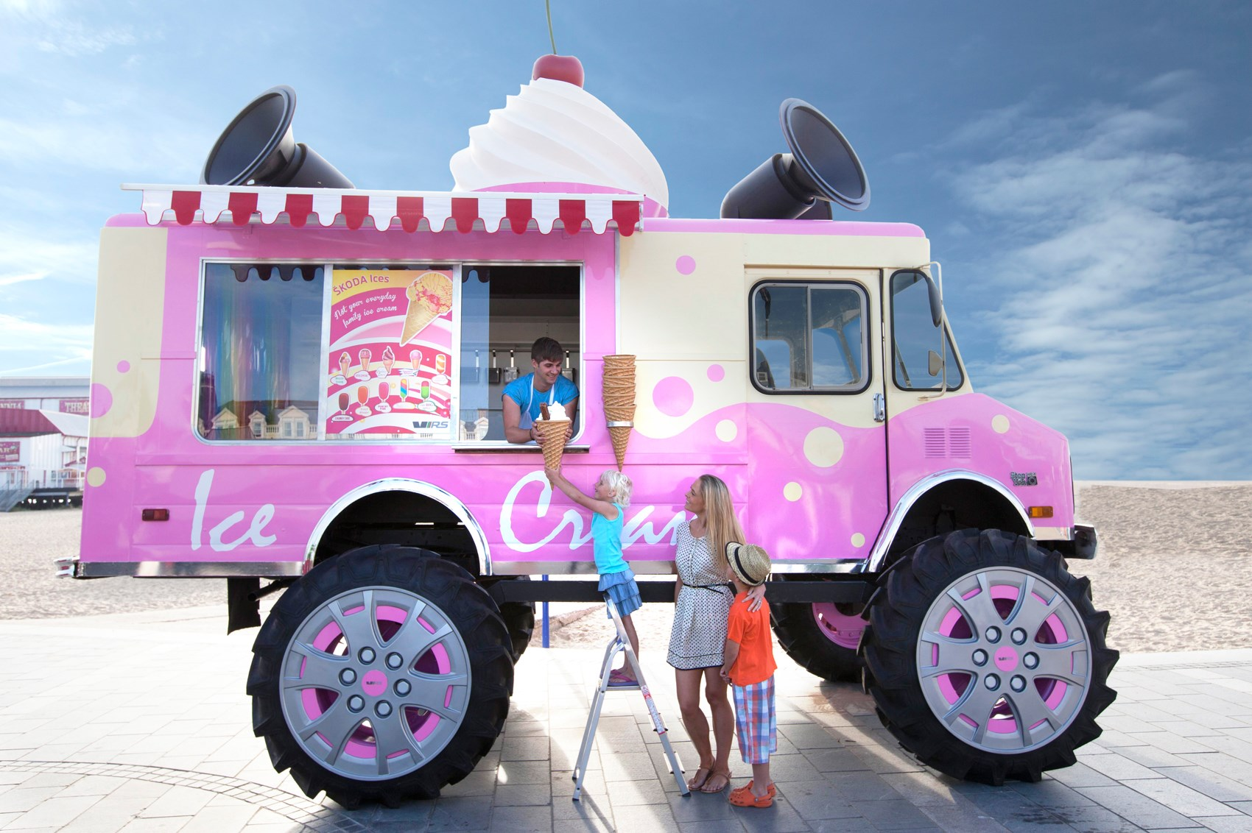
Supervised Learning Recap
Machine learning algorithms enable our computers to learn from provided data
Predictions / decisions can be made without explicitly programming every possible scenario
Our focus today is on supervised learning
A type of machine learning where we give a computer data with labels. The computer then makes predictions with new data
Car
Car
Not Car
Car
Notes:
Human with a robot
Human tells the robot whether or not something is a car…
Human provides an image and a label

Slide 7
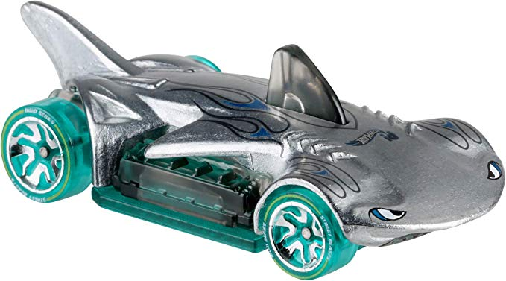
Supervised Learning Recap
Machine learning algorithms enable our computers to learn from provided data
Predictions / decisions can be made without explicitly programming every possible scenario
Our focus today is on supervised learning
A type of machine learning where we give a computer data with labels. The computer is then makes predictions with new data
Is this a car?
Notes:
Now the robot must determine if a new image is a car

Slide 8
Supervised Learning Recap
Machine learning algorithms enable our computers to learn from provided data
Predictions / decisions can be made without explicitly programming every possible scenario
Our focus today is on supervised learning
A type of machine learning where we give a computer data with labels. The computer is then makes predictions with new data
Is this a car?
Wheels? ✅
Headlights?✅
Notes:
Consider the labels and features
Labels are car / not car
Features are: wheels? Headlights?

Slide 9
Last Class
Our focus was linear regression and logistic regression
Both are types of supervised learning
In-class example:
Battery life was the label
We trained a computer to predict the battery life based on screen size and phone weight.
We found that a phone uses less battery when the phone was lighter and the screen was smaller.

Slide 10
Classification
Classification: A type of supervised learning problem where we want to determine what class each example belongs to
Car Class
Not Car Class
Notes:
Similar to before we have a one image that belongs to the car class and another image that belongs to the not car class

Slide 11
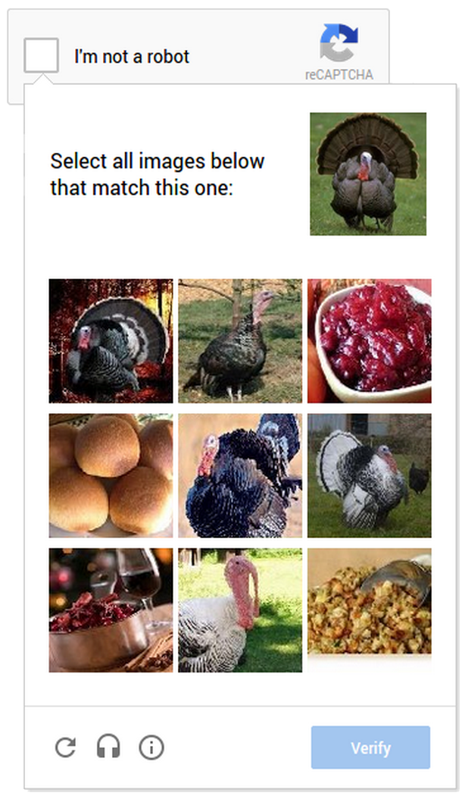
The Classification Exercise
Classification: A type of supervised learning problem where we want to determine what class each example belongs to
Classify if an image contains a turkey
What are the classes?
What are the examples? Or, what do you want to sort?
Notes:
Who has seen

Slide 12
Binary and Multiclass Classification
Binary Classification: When there are only two classes
Examples:
Are you sick?
Does the picture have a dog?
Multinomial Classification: When there are many classes
Examples:
What genre of music is this song? (e.g. rock, rap, country)
What object is in this picture?
Notes:
Binary classification - Think yes/no or true/false

Slide 13

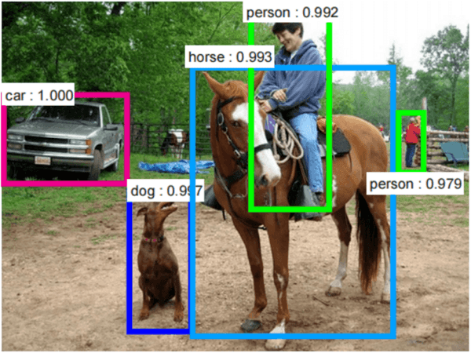
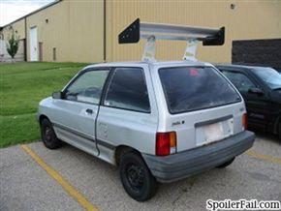
Binary and Multiclass Classification
Car: 100%
Binary
Multinomial
Notes:
Image on the left: Though a fire detector doesn’t use AI, the task of deciding whether there’s a fire or no fire (two specific classes) is an example of binary classification (imagine an AI system that must predict fire or no fire in a forest)
Image on the right: object recognition example; could be important for various applications, such as with self-driving cars (the numbers next to the objects are how confident the system thinks it’s those things, from 0 to 1) -- notice there are many different classes of objects

Slide 14
Table Discussions
What are applications of classification?
What would the examples be?
What would the labels be?
Is this binary or multinomial classification?

Slide 15
General Approach to Classification
We want to build a model that assigns the correct class (label) to an example
The model is also known as a classifier
What we need:
Identify what the data type is (image? text? numbers?)
Notes:
Features were mentioned in the Intro to ML lecture and they should be familiar with the concept (they did an activity on it as well) -- it’s worth asking them again what a feature is
“Training set” was also covered in Intro to ML

Slide 16
General Approach to Classification
We want to build a model that assigns the correct class (label) to an example
The model is also known as a classifier
What we need:
Identify what the data type is (image? text? numbers?)
Identify what the classes (labels) will be
Car Class
Not Car Class
Notes:
Features were mentioned in the Intro to ML lecture and they should be familiar with the concept (they did an activity on it as well) -- it’s worth asking them again what a feature is
“Training set” was also covered in Intro to ML

Slide 17
General Approach to Classification
We want to build a model that assigns the correct class (label) to an example
The model is also known as a classifier
What we need:
Identify what the data type is (image? text? numbers?)
Identify what the classes (labels) will be
Identify what features we care about
Wheels? ✅
Headlights?✅
Notes:
Features were mentioned in the Intro to ML lecture and they should be familiar with the concept (they did an activity on it as well) -- it’s worth asking them again what a feature is
“Training set” was also covered in Intro to ML

Slide 18
General Approach to Classification
We want to build a model that assigns the correct class (label) to an example
The model is also known as a classifier
What we need:
Identify what the data type is (image? text? numbers?)
Identify what the classes (labels) will be
Identify what features we care about
Training Set: A dataset of already labelled examples
Car
Car
Not Car
Car
Notes:
Features were mentioned in the Intro to ML lecture and they should be familiar with the concept (they did an activity on it as well) -- it’s worth asking them again what a feature is
“Training set” was also covered in Intro to ML

Slide 19
Steps to Classification
Train our classifier on the training set
Show our “robot” all the examples and classes
Run our classifier on new, unseen examples in the test set
Evaluate how our classifier performed
Modify and re-train our classifier to do better!
Car Class
Not Car Class

Slide 20
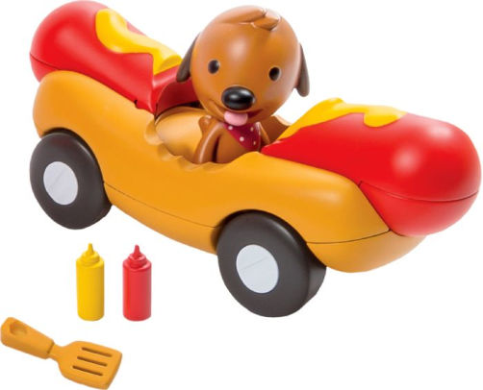
Steps to Classification
Train our classifier on the training set
Show our “robot” all the examples and classes
Run our classifier on new, unseen examples in the test set
Evaluate how our classifier performed
Modify and re-train our classifier to do better!
This is a car
This is NOT a car
Car Class
Not Car Class

Slide 21
Steps to Classification
Train our classifier on the training set
Show our “robot” all the examples and classes
Run our classifier on new, unseen examples in the test set
Evaluate how our classifier performed
Modify and re-train our classifier to do better!
This is a car
✅
This is NOT a car
❌
Car Class
Not Car Class

Slide 22
Steps to Classification
Train our classifier on the training set
Show our “robot” all the examples and classes
Run our classifier on new, unseen examples in the test set
Evaluate how our classifier performed
Modify and re-train our classifier to do better!
This is a car
✅
This is NOT a car
❌
Car Class
Not Car Class

Slide 23
Classification Algorithms
We will learn 2 classification algorithms today:
Decision Trees
Nearest Neighbors

Slide 24
Classification Algorithms
We will learn 2 classification algorithms today:
Decision Trees
Nearest Neighbors
We will learn 2 more approaches in the future:
Naive Bayes
Neural Networks

Slide 25
Classification Algorithms
We will learn 2 classification algorithms today:
Decision Trees
Nearest Neighbors
We will learn 2 more approaches in the future:
Naive Bayes
Neural Networks
Different classification algorithms will:
Make use of the training data in different ways
Make classification decisions in different ways
Make different assumptions about your data
Notes:
Why are different classification algorithms important

Slide 26
Decision Trees

Slide 27
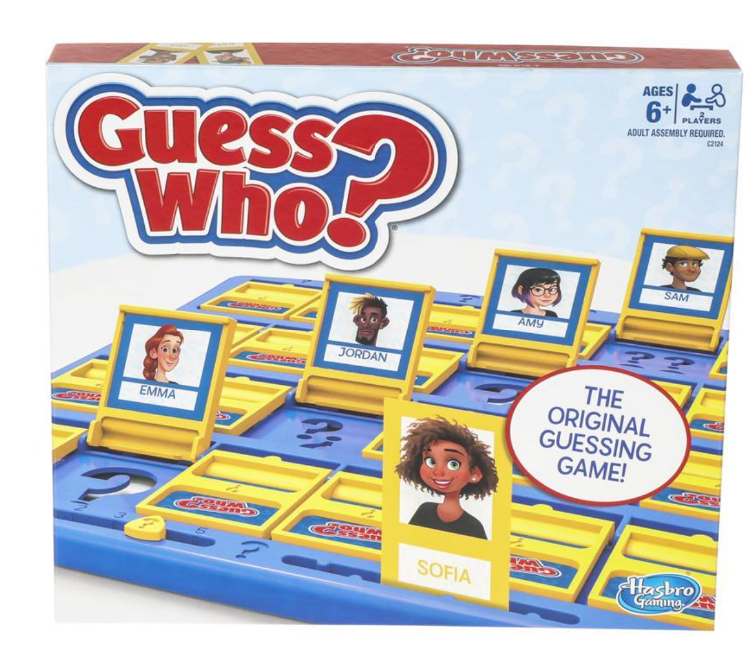
“Guess Who?” Activity
Find a partner for this activity
Directions:
You will see a grid of pictures of animals
Both of you will choose an animal and keep the choice a secret
The goal is to guess the other person’s animal first
You will each take turns asking yes or no questions to narrow down the choices (e.g., “Does your animal have two legs?”)
Keep track of the number of questions you’ve asked
If you don’t know the answer, you can say “I don’t know”
If you think you have figured out the animal, you can guess instead of asking a question on your turn
The winner is the first person to guess the other’s animal!
Notes:
Maybe have them play for ~5 minutes -- give them enough time to play 2-3 rounds

Slide 28
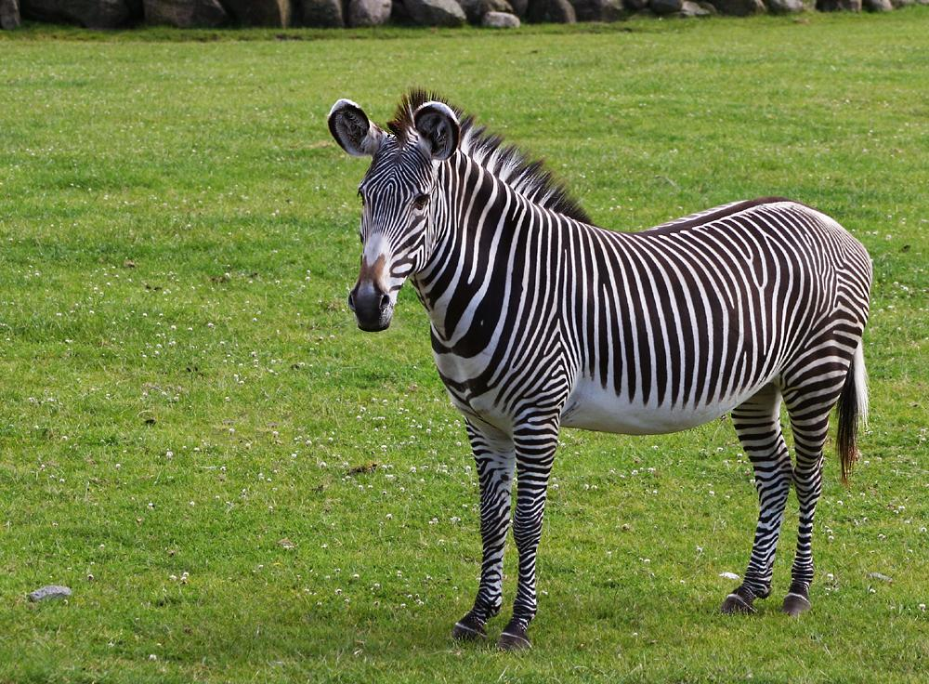
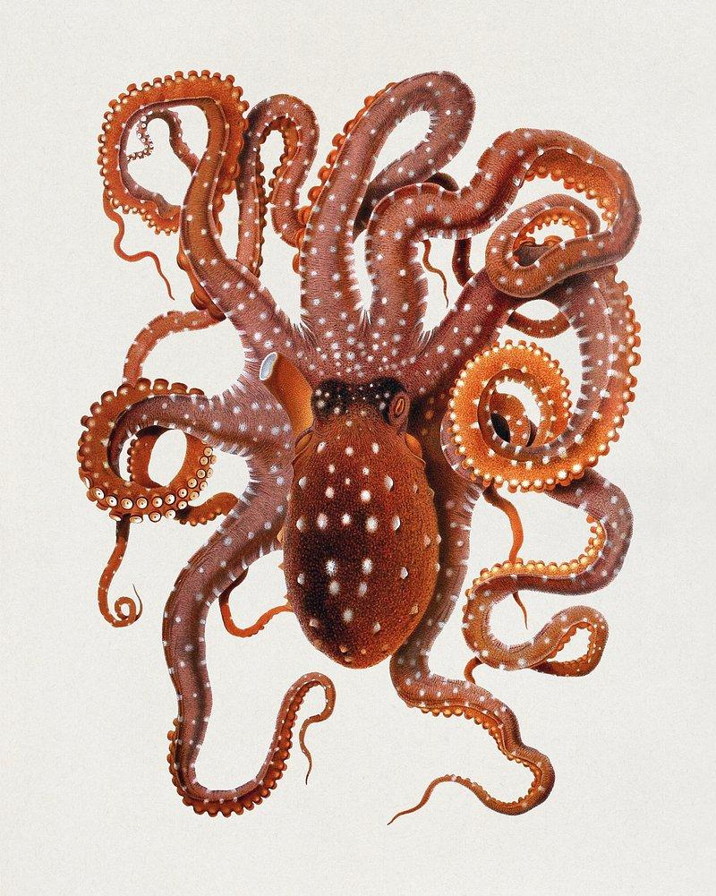
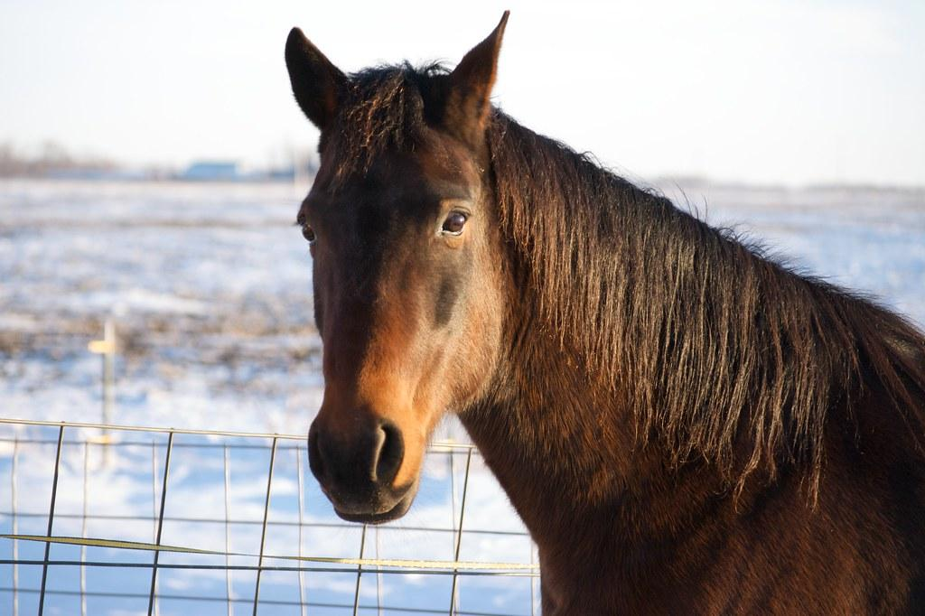
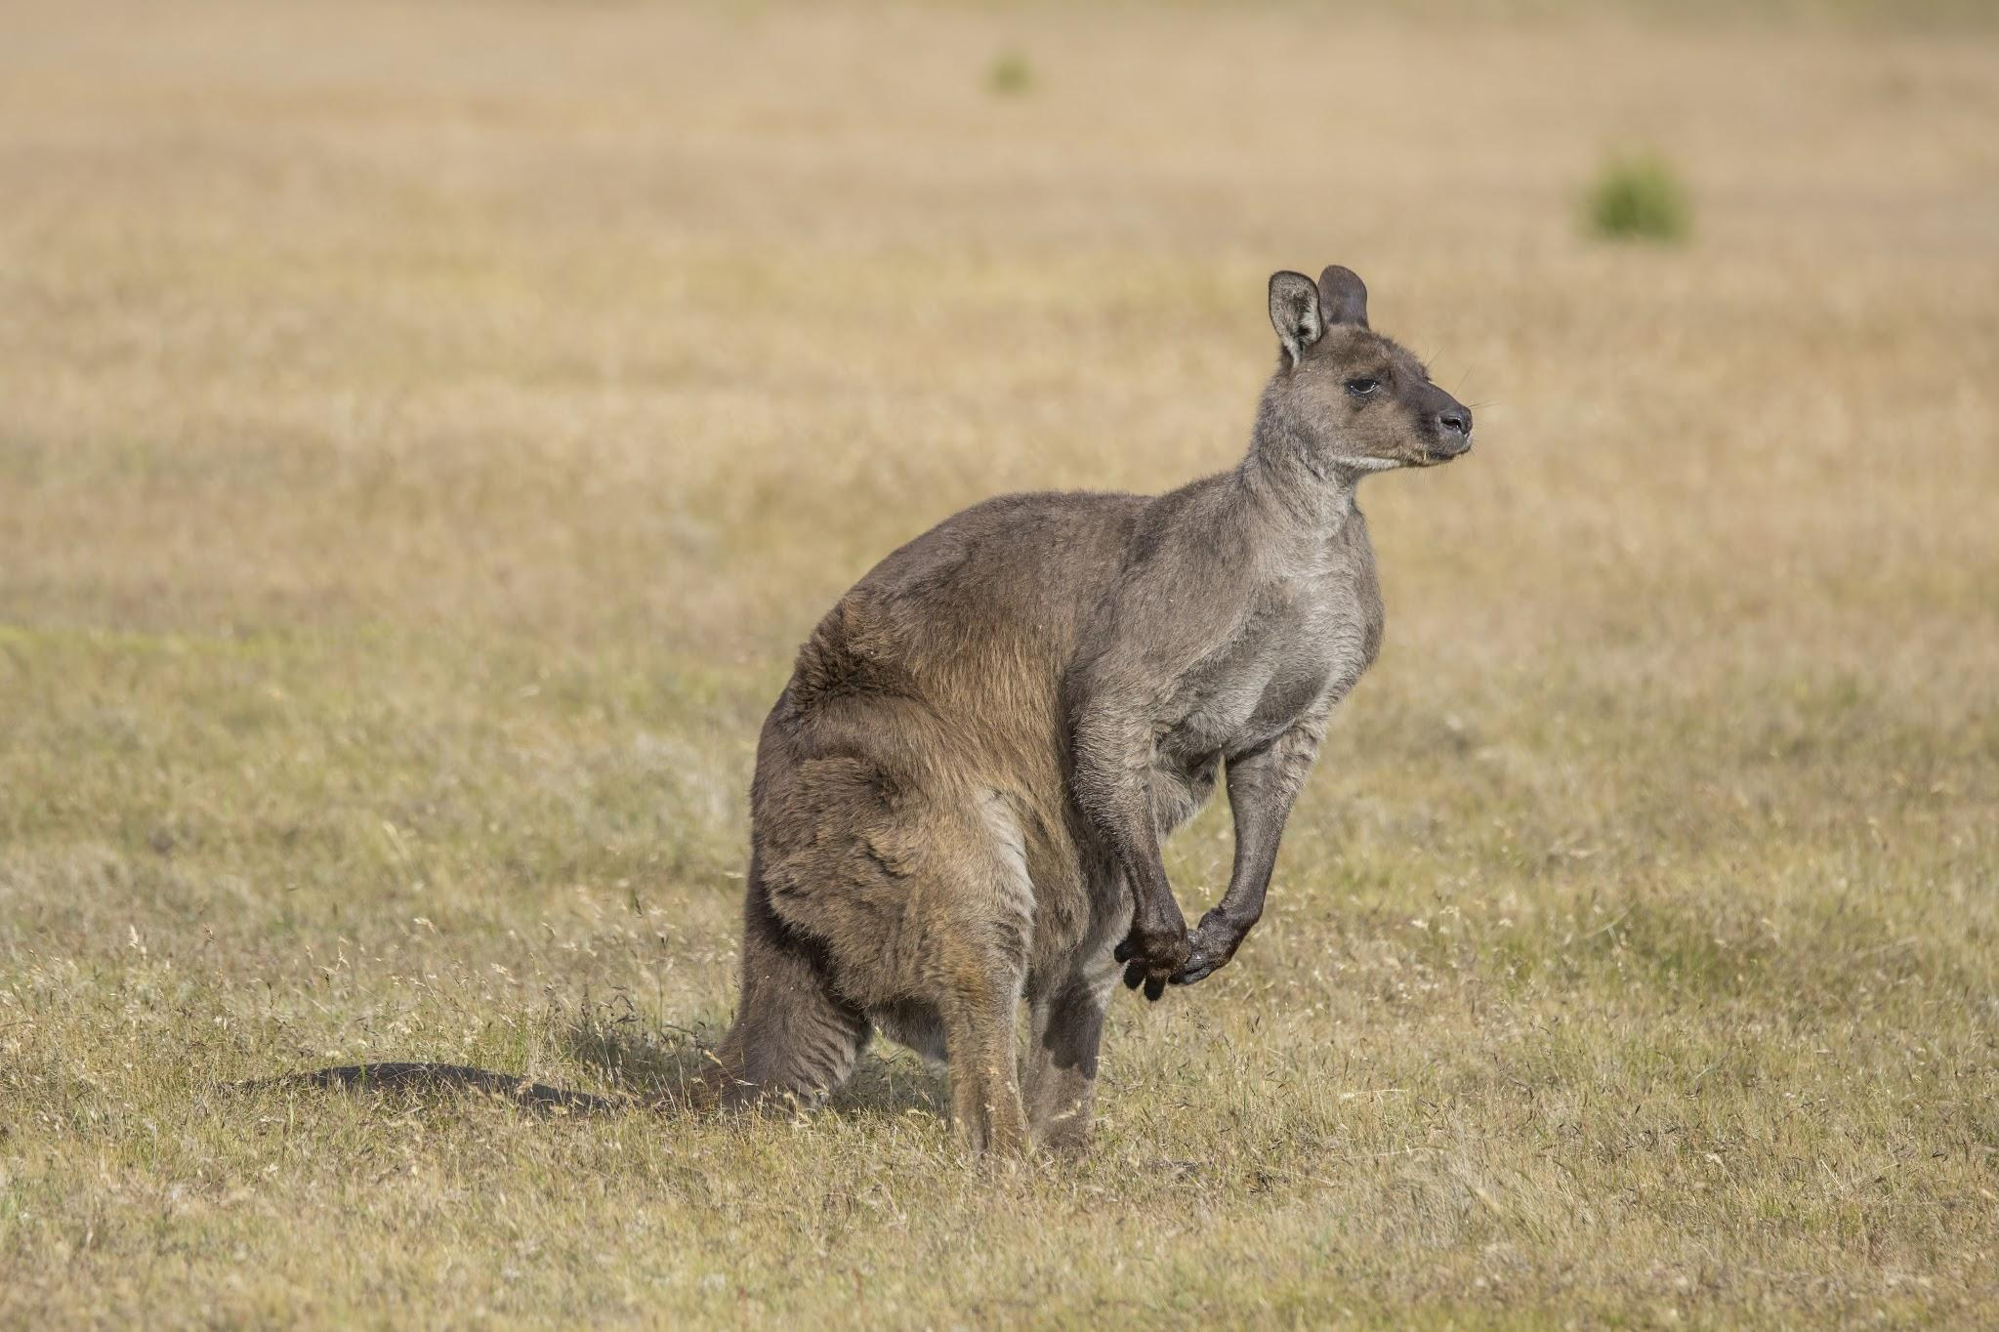
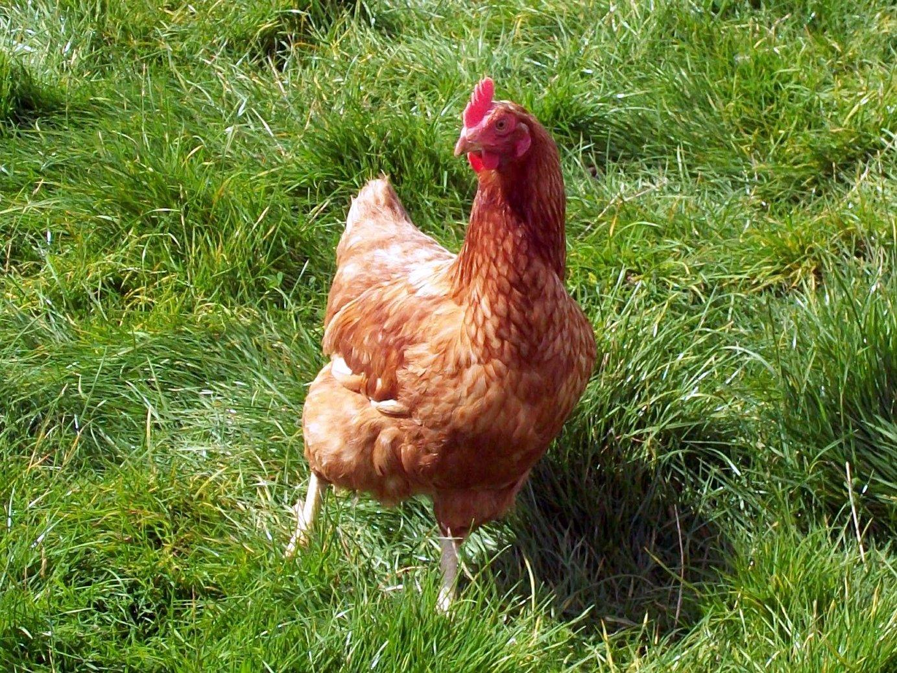
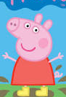
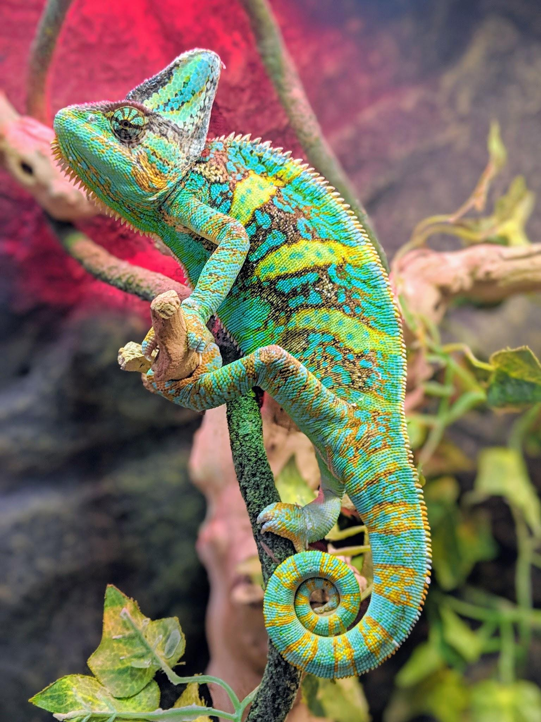
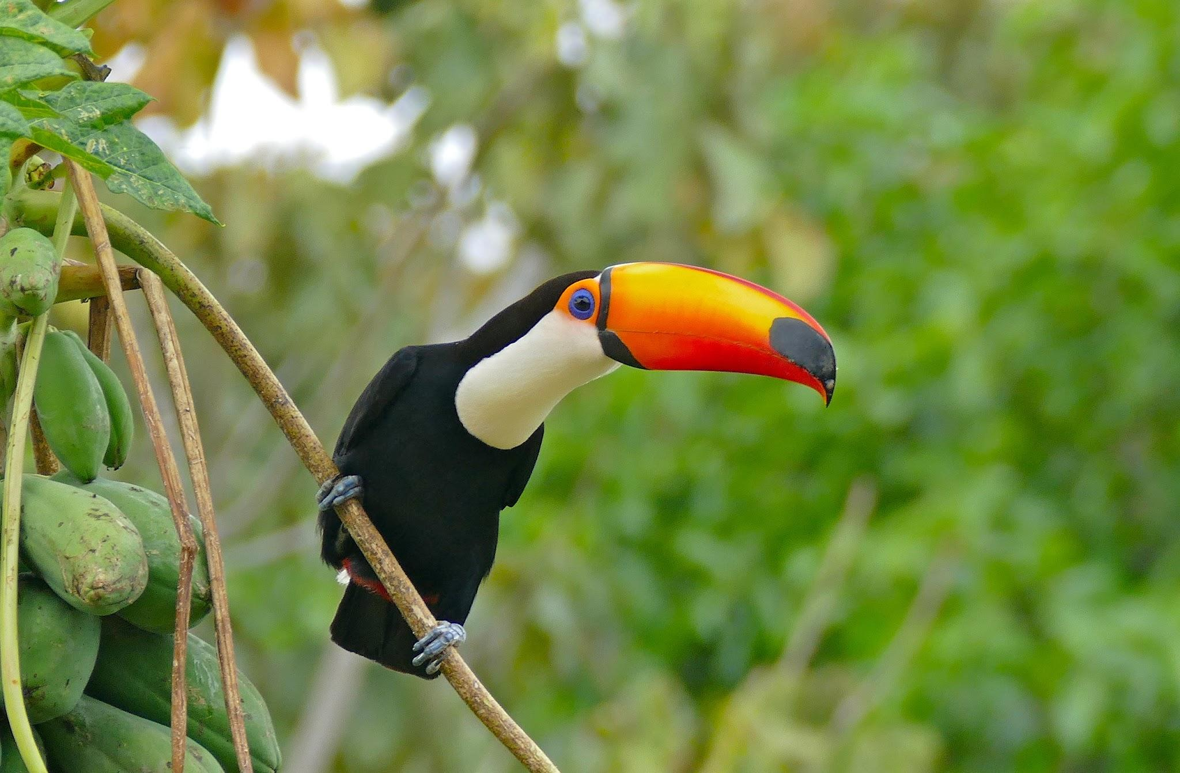
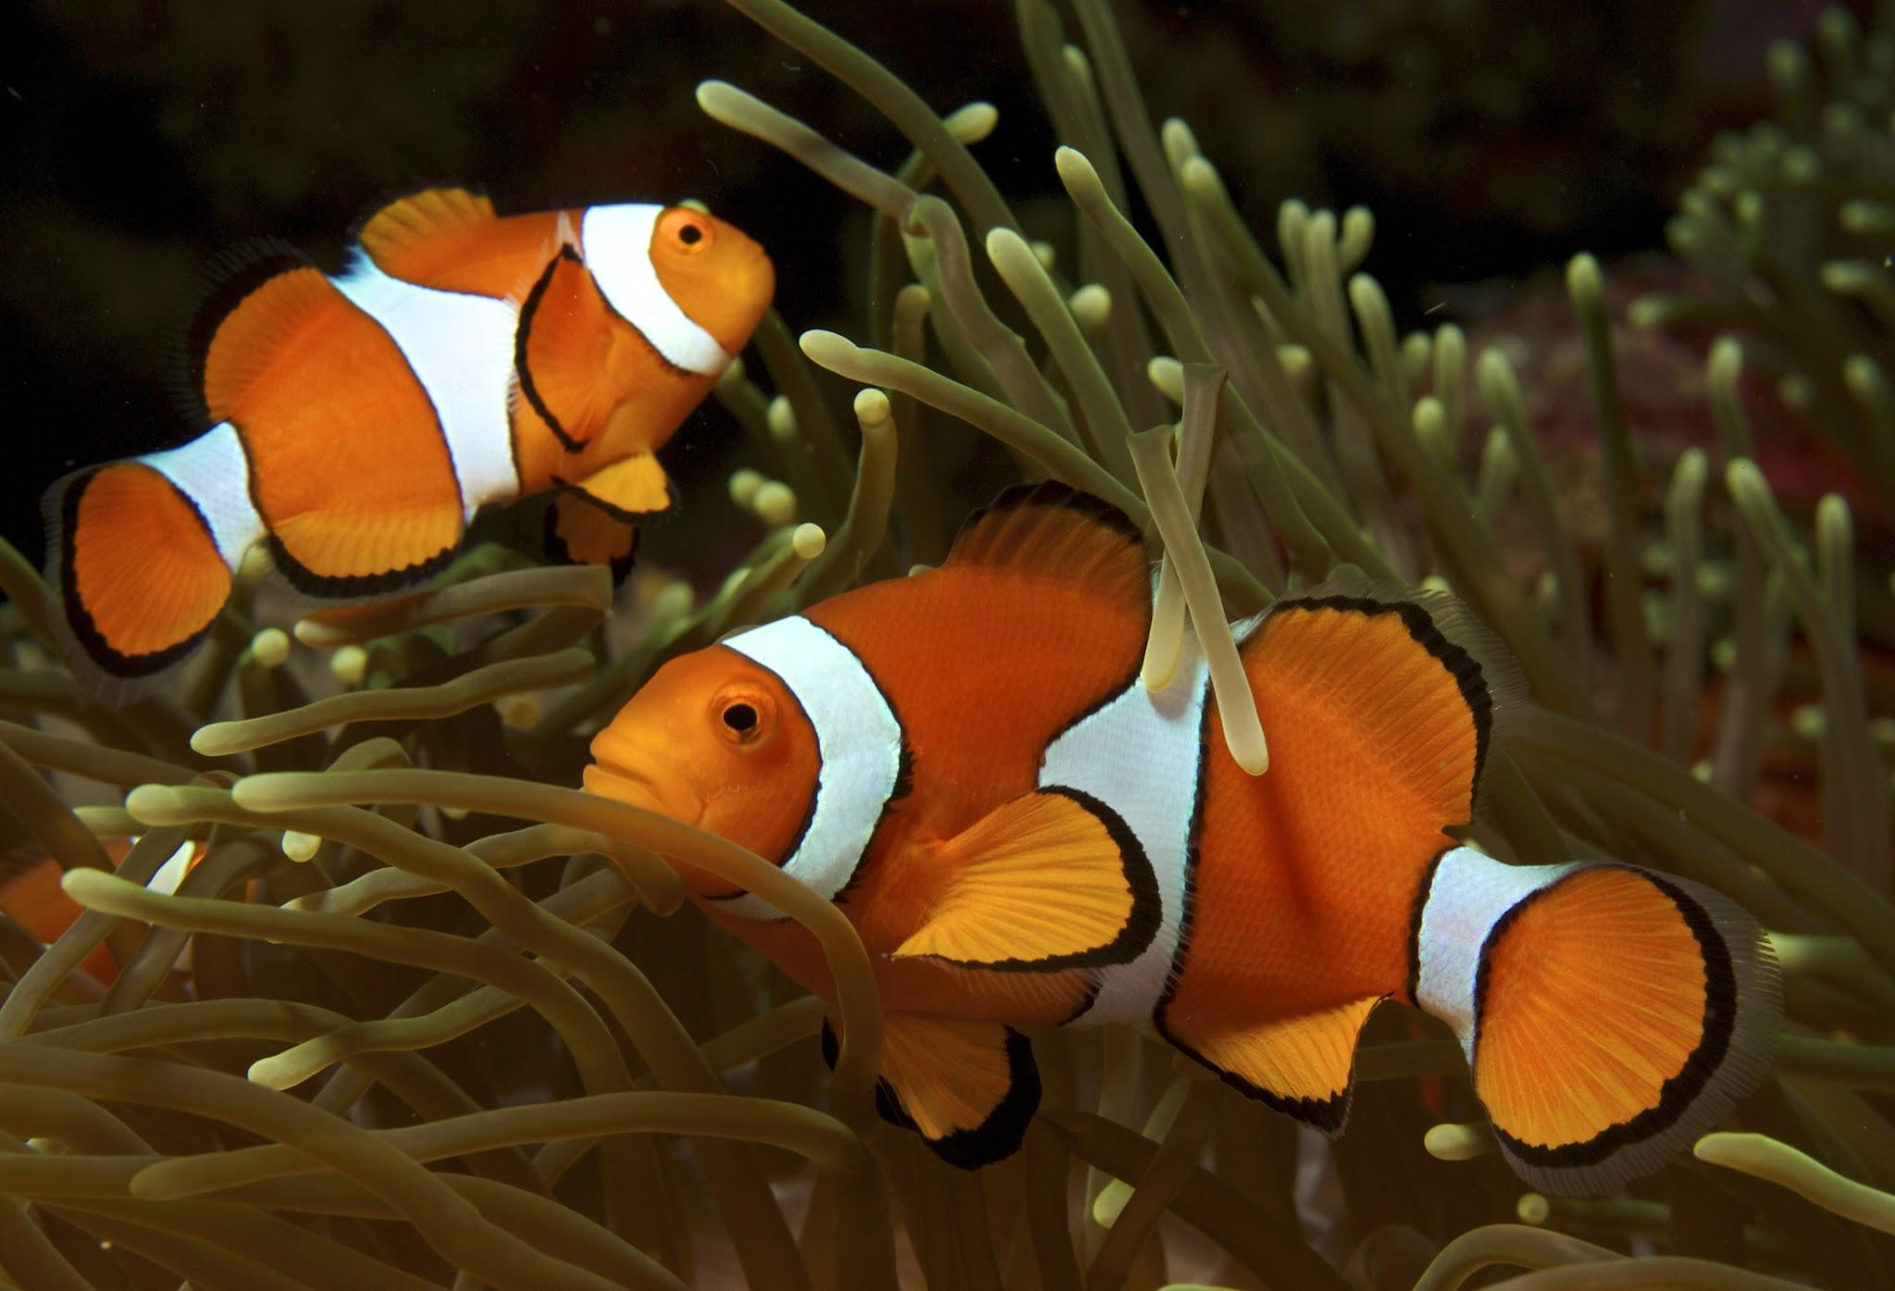
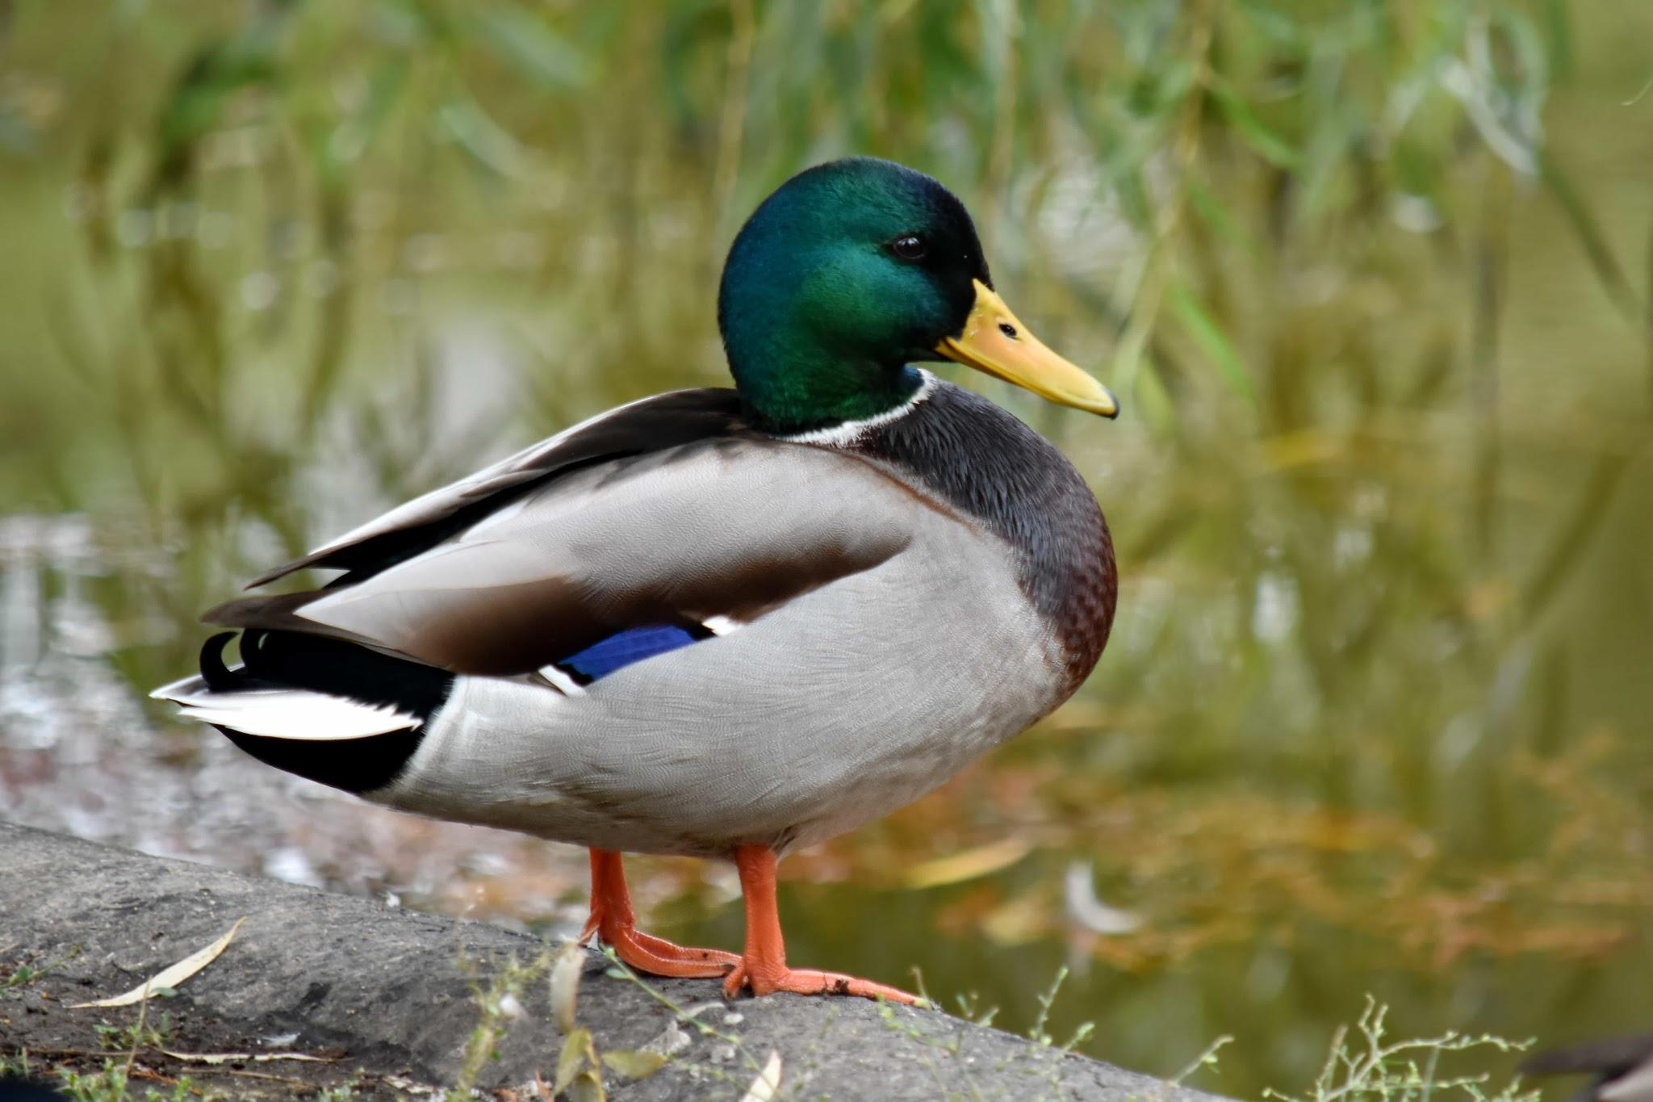
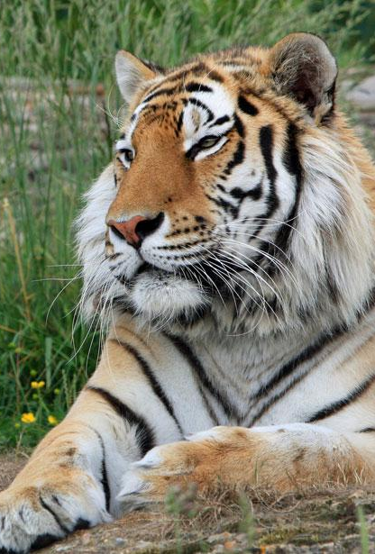
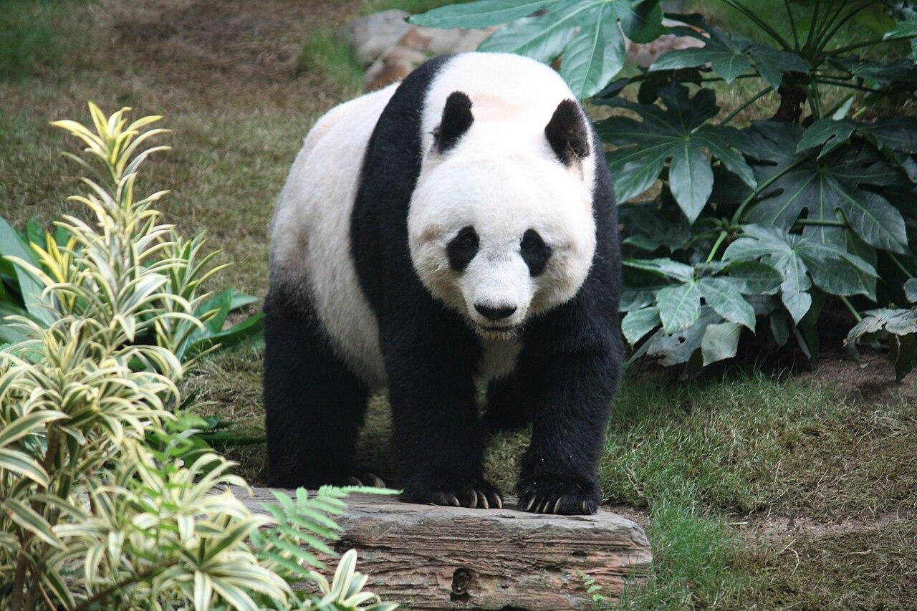
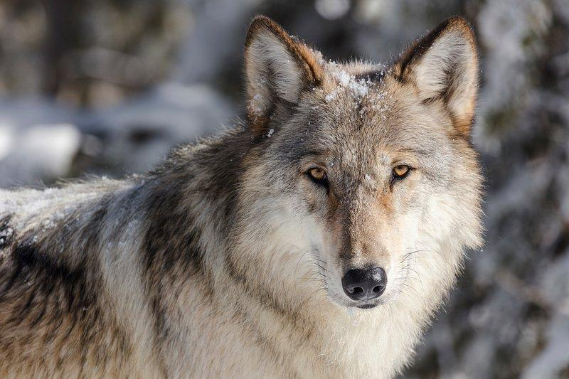
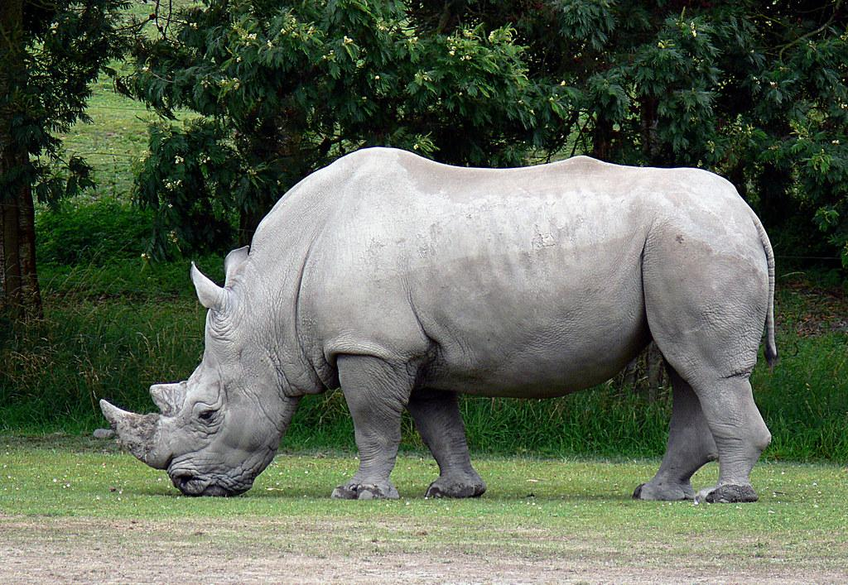
Guess Who?
Zebra
Octopus
Horse
Kangaroo
Chicken
Pig
Chameleon
Toucan
Clownfish
Duck
Tiger
Panda
Wolf
Rhino
Notes:
Keep this slide up as they play the activity

Slide 29
Guess Who? Wrap-up
In this activity, what sorts of questions helped narrow down the options more quickly?
What were the features you used in the activity?
Imagine an algorithm that figures out the best way to find the animal in the least amount of questions!
Notes:
Features here might include things like hair color, if they were holding a microphone in the picture, male/female, etc.

Slide 30
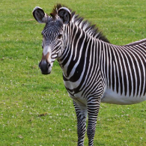

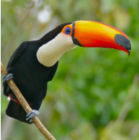
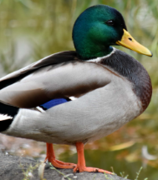
Good Q’s, bad Q’s, and lucky Q’s
Y
Zebra
Stripes?
Y
Horsey
N
Four legs?
Y
N
Toucan
Orange
beak?
Duck
N
Notes:
Features here might include things like hair color, if they were holding a microphone in the picture, male/female, etc.

Slide 31

Good Q’s, bad Q’s, and lucky Q’s
Y
Has a degree in nuclear physics?
N
Notes:
Features here might include things like hair color, if they were holding a microphone in the picture, male/female, etc.

Slide 32
Good Q’s, bad Q’s, and lucky Q’s
Y
Y
Toucan?
Toucan?
N
N
Y
Toucan?
N
Notes:
Features here might include things like hair color, if they were holding a microphone in the picture, male/female, etc.

Slide 33
Good Q’s, bad Q’s, and lucky Q’s
Y
Zebra?
N
Notes:
Features here might include things like hair color, if they were holding a microphone in the picture, male/female, etc.

Slide 34
Question
Based on this example, how can we turn multinomial classification (many categories) into binary classification (two categories) but done multiple times?

Slide 35
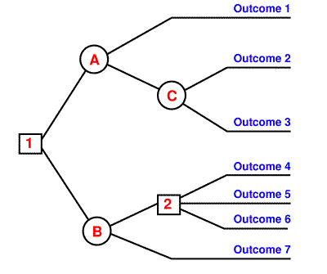
Decision Tree
An algorithm for classification that makes decisions by splitting up the training set based on specific features

Slide 36
Decision Tree
An algorithm for classification that makes decisions by splitting up the training set based on specific features
When trying to decide how to classify an example, we will ask a series of questions (usually yes/no)

Slide 37
Decision Tree
An algorithm for classification that makes decisions by splitting up the training set based on specific features
When trying to decide how to classify an example, we will ask a series of questions (usually yes/no)
Which questions we ask will depend on what the training set looks like

Slide 38
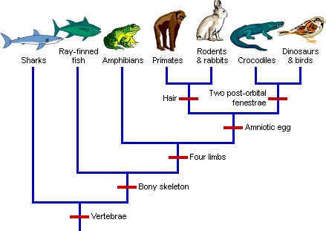
Decision Tree
By splitting up the possible outcomes at each question, we create a diagram that looks like an evolutionary tree

Slide 39
Decision Tree
By splitting up the possible outcomes at each question, we create a diagram that looks like a family tree
We call this a rule-based classifier because at each step, we follow a specific rule to make a decision

Slide 40
Decision Tree
By splitting up the possible outcomes at each question, we create a diagram that looks like a family tree
We call this a rule-based classifier because at each step, we follow a specific rule to make a decision
Decision trees make it very clear how we ended up at a certain conclusion because we can trace which questions we asked along the way

Slide 41
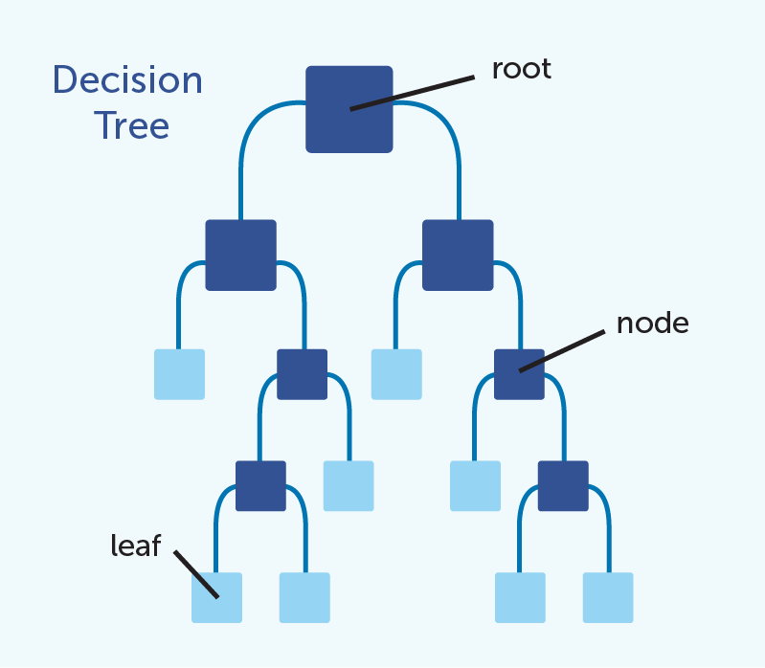
Parts of a Tree
Children
(of the root)
Notes:
Create a new unified graphic for this slide
For decision trees, leaf nodes (light blue) are all classes; interior nodes (dark blue) are all questions/rules that split the dataset
Root: is the top most node. It represents the starting point for making decisions. It is the initial question
Node: points within a decision tree (represent questions we ask)
Leaf Nodes: endpoints of the decision tree
Children: represent the possible outcomes from the node above

Slide 42
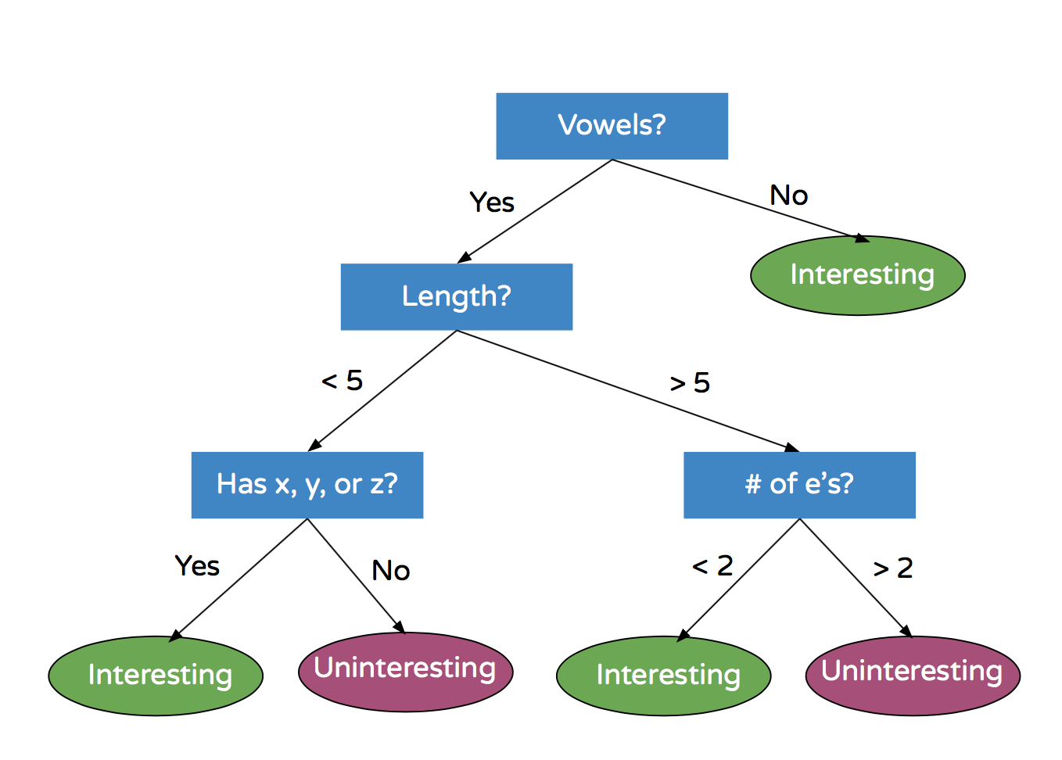
Example
How would we classify the following words according to this decision tree?
Tsk
Infinity
Needed
Zen
Notes:
Interesting or Uninteresting Words

Slide 43
Example
How would we classify the following words according to this decision tree?
Tsk - Interesting
Infinity
Needed
Zen

Slide 44
Example
How would we classify the following words according to this decision tree?
Tsk - Interesting
Infinity - Interesting
Needed
Zen

Slide 45
Example
How would we classify the following words according to this decision tree?
Tsk - Interesting
Infinity - Interesting
Needed - Uninteresting
Zen

Slide 46
Example
How would we classify the following words according to this decision tree?
Tsk - Interesting
Infinity - Interesting
Needed - Uninteresting
Zen - Interesting
Notes:
Decision tree to classify if a word is interesting or not

Slide 47
Learning a Decision Tree
We saw how to follow a decision tree, but how do we build, or learn, it?

Slide 48
Learning a Decision Tree
We saw how to follow a decision tree, but how do we build, or learn, it?
This is where Machine Learning comes in!

Slide 49
Learning a Decision Tree
We saw how to follow a decision tree, but how do we build, or learn, it?
This is where Machine Learning comes in!
We use our training data to build a decision tree

Slide 50
Learning a Decision Tree
We saw how to follow a decision tree, but how do we build, or learn, it?
This is where Machine Learning comes in!
We use our training data to build a decision tree
We want to build a decision tree that:
Classifies the examples in our training set correctly
Generalizes to new examples well

Slide 51
Steps for learning decision trees
Look at all of your training data
Notes:
Need to build out an example?

Slide 52
Training Data
A
A
B
Learn a tree that classifies A vs. B the best
B
A
B
B
A
Notes:
To motivate the steps for building a decision tree, we’ll look at this example
How can you build a tree that most efficiently classifies the training set, in the least amount of splits? (Or in “Guess Who” terms, in the least amount of questions?)

Slide 53
Steps for learning decision trees
Look at all of your training data
Select the feature that gives the “best split”
Notes:
We’ll talk about what the “best split” is afterwards

Slide 54
Feature(s):
Green Squares?
A
A
B
B
A
B
B
A

Slide 55
Feature(s):
Green Squares?
A
A
B
B
B
A
B
A
A Bad Split
Try Again
Notes:
You can imagine, one way to split the data is to say: Label all green squares as group B
This… probably is not a very good split, because we still have 7 more objects we need to label

Slide 56
Feature(s):
Reds?
A
A
B
B
A
B
B
A

Slide 57
Feature(s):
Reds?
A
A
B
B
B
A
A
B
Better Split
Try Again
Notes:
You can imagine, one way to split the data is to say: Label all green squares as group B
This… probably is not a very good split, because we still have 7 more objects we need to label

Slide 58
Feature(s):
Blues
A
A
B
B
A
B
B
A

Slide 59
Feature(s):
Blues
B
A
A
A
B
B
A
B
Label as group A
Much Better Split
Notes:
This is a much better split, because it nearly splits the training set into two groups, by looking at the Blue feature -- and all of the Blue shapes are corectly group A
Is there a better split we can do? How do we know this is the “best split”?
There’s actually some math to this! We’ll look at this later

Slide 60
Steps for learning decision trees
Look at all of your training data
Select the feature that gives the “best split”
Create a node in the tree based on this split

Slide 61
Our Decision Tree So Far
Blue?
No
Yes
Still building
Still building
Notes:
We’ll see why we’re “still building” in the following steps

Slide 62
Steps for learning decision trees
Look at all of your training data
Select the feature that gives the “best split”
Create a node in the tree based on this split
Separate your training data based on this split

Slide 63
Our Decision Tree So Far
Blue?
A
B
No
A
A
Yes
A
B
B
Still building
Still building
B

Slide 64
Steps for learning decision trees
Look at all of your training data
Select the feature that gives the “best split”
Create a node in the tree based on this split
Separate your training data based on this split
For each group, repeat steps 2 to 4 until either:
Your examples are perfectly classified! -or -
You’ve already split the tree a certain number of times
example: you stop 20 questions when you have either:
a. guessed the celebrity or
b. reached 20 questions
(otherwise this could go on forever…)
Notes:
We can pick what number of examples we want to stop at -- for this example, let’s say 3
We can also pick the max number of times we split the tree -- for this example, let’s say 4
These are numbers that we are arbitrarily picking for this example -- you could have done it with different numbers

Slide 65
Our Decision Tree So Far
Blue?
A
B
No
A
A
Yes
A
B
B
Still building
Still building
B
Conditions:
All same class
Tree is deeper than 4 questions

Slide 66
Our Decision Tree So Far
Blue?
A
B
No
A
A
Yes
A
B
B
Still building
Still building
Condition met: All same class (group A)
B
Conditions:
All same class
Tree is deeper than 4 questions

Slide 67
Our Decision Tree So Far
Blue?
A
B
No
A
A
Yes
A
B
B
Group A
Still building
B
Conditions:
All same class
Tree is deeper than 4 questions

Slide 68
Our Decision Tree So Far
Blue?
A
B
No
A
A
Yes
A
B
B
Group A
Still building
B
Mix of class A, B
Tree is 1 Q long
→ keep building
Conditions:
All same class
Tree is deeper than 4 questions

Slide 69
Steps for learning decision trees
Look at all of your training data
Select the feature that gives the “best split”
Create a new node in the tree based on this split
Separate your training data based on this split
For each group, repeat steps 2 to 4 until one of the following is met:
All examples in the group have the same class
The group has less than some number of examples
You’ve already split the tree a certain number of times
If met, create a child node that represents the class

Slide 70
Examples on Right Branch
B
A
B
B
B
Notes:
Remember we just care about the remaining examples now

Slide 71
Feature:
Green Circle
B
B
B
A
B
All group B
Notes:
Earlier, we tried splitting based on being a circle, but that didn’t give a clean split. What about this time? With the blue examples gone, we actually see that splitting by circles gives us 3 correct classifications!

Slide 72
Steps for learning decision trees
Look at all of your training data
Select the feature that gives the “best split”
Create a new node in the tree based on this split
Separate your training data based on this split
For each group, repeat steps 2 to 4 until one of the following is met:
All examples in the group have the same class
You’ve already split the tree a certain number of times
If met, create a child node that represents the class

Slide 73
Our Decision Tree So Far
Blue?
A
B
A
A
Yes
A
Grn Circle?
B
B
Group A
Yes
No
B

Slide 74
Steps for learning decision trees
Look at all of your training data
Select the feature that gives the “best split”
Create a new node in the tree based on this split
Separate your training data based on this split
For each group, repeat steps 2 to 4 until one of the following is met:
All examples in the group have the same class
You’ve already split the tree a certain number of times
If met, create a child node that represents the class

Slide 75
Our Decision Tree So Far
Blue?
A
A
B
Yes
A
Grn Circle?
B
Group A
B
Yes
No
B
A

Slide 76
Steps for learning decision trees
Look at all of your training data
Select the feature that gives the “best split”
Create a new node in the tree based on this split
Separate your training data based on this split
For each group, repeat steps 2 to 4 until one of the following is met:
All examples in the group have the same class
You’ve already split the tree a certain number of times
If met, create a child node that represents the class

Slide 77
Our Decision Tree So Far
Blue?
A
B
A
Yes
A
Grn Circle?
B
Group A
B
Yes
No
B
A
Conditions:
All same class
Tree is deeper than 4 questions

Slide 78
Our Decision Tree So Far
Blue?
A
B
A
Yes
A
Grn Circle?
B
Group A
B
Yes
No
B
A
All same class
Conditions:
All same class
Tree is deeper than 4 questions

Slide 79
Our Decision Tree So Far
Blue?
A
B
A
Yes
A
Grn Circle?
B
Group A
B
Yes
No
B
A
All same class
All same class
Conditions:
All same class
Tree is deeper than 4 questions

Slide 80
Our Decision Tree So Far
Blue?
A
B
A
Yes
A
Grn Circle?
B
Group A
B
Yes
No
B
A
Group A
Group B
Conditions:
All same class
Tree is deeper than 4 questions

Slide 81
Our Final Decision Tree… if we had stopped at 1 Q
Blue?
A
B
A
Yes
A
Group B
B
Group A
B
A
B
😱
Note 1: How well our decision tree fits our training data depends on the number of questions we allow.
Notes:
We’re done!

Slide 82
Decision Trees and Overfitting
Blue?
A
No
B
A
Yes
A
Grn Circle?
B
Group A
B
Yes
No
B
Group A
Group B
New Data:
A
A
Note 2: If we ask too many questions, our decision tree is too specific to our training data and maybe doesn’t predict new shapes well. This is called overfitting.
Notes:
We’re done!

Slide 83
Activity
https://tinyurl.com/tf7axujb
Follow this interactive explanation of decision trees used to classify whether a home is located in San Francisco or New York City.
Notes:
~10 minutes for this activity -- if low on time, can get them to do later
Can someone give me the labels: New York City Home vs San Francisco Home
Can someone give me the features: hight, price per square foot, year built, price, square feet, bedrooms, bathrooms
Can someone explain the technique used to classify the new data.
How well did the model work for training data
How well did the model work for the testing data
Training - train model
Testing - used trained model on unseen data
overfitting? Accurate predictions for train but not testing

Slide 84
Summary
A decision tree is a simple and fast way to do classification based on asking questions about one feature at a time
Built by identifying “best splits” in the training data
Very easy to understand why certain decisions are made
Easy to follow how the algorithm makes its classification decisions (not the case for more complex algorithms!)
Notes:
Neural networks aren’t as clear why specific things are happening… this is bc of complex layers

Slide 85
Nearest Neighbors
Notes:
Moving to another classification algorithm

Slide 86
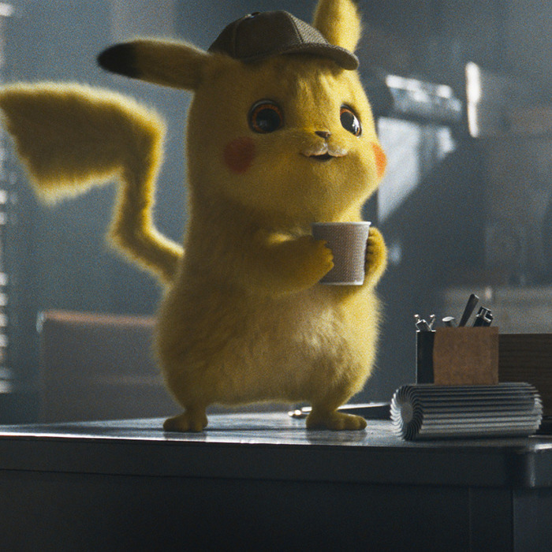
Nearest Neighbors
?
Assume that similar examples should be classified the same
E.g. if I like pizza bagels, I’ll (probably) also like pizza
Simplest version: For your new image, look for the most similar example in your training set, and give it the same classification

Slide 87
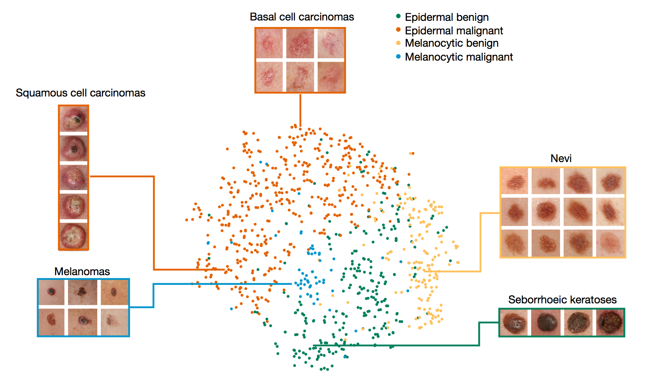
What does “closest” mean?
Let’s take the task of classifying a skin image as cancerous or not
Let’s describe each picture example by two features:
Darkness
Size
For a new image, the “closest” image would be the image with the most similar darkness and size

Slide 88
It’s Easier to Find Nearest Neighbors on a Graph
Each axis describes a feature
Examples are represented as points on a graph
Now, we can describe each picture mathematically as its coordinates (darkness, size)
So an example could be (0.5, 0.6), meaning darkness is 0.5 and size is 0.6
Similarity is dependent on the distance to other examples on the graph
size
darkness

Slide 89
Nearest Neighbors Steps
Plot the labelled training set examples on a graph based on the features we have selected
bad
size
bad
good
darkness

Slide 90
Nearest Neighbors Steps
Plot the labelled training set examples on a graph based on the features we have selected
When we’re given a new, unseen example, plot it on the graph based on its features
bad
size
bad
good
darkness

Slide 91
Nearest Neighbors Steps
Plot the labelled training set examples on a graph based on the features we have selected
When we’re given a new, unseen example, plot it on the graph based on its features
Compute the distance from the new example to all of our training examples
bad
y: size
bad
good
x: darkness

Slide 92
Nearest Neighbors Steps
Plot the labelled training set examples on a graph based on the features we have selected
When we’re given a new, unseen example, plot it on the graph based on its features
Compute the distance from the new example to all of our training examples
Assign the example a classification based on the classification of the closest example
bad
size
good
bad
good
darkness

Slide 93
K-Nearest Neighbors (KNN)
An extension of Nearest Neighbors
Instead of only looking at the one nearest neighbor, it looks at the k nearest neighbors
k is a parameter that we get to pick
This is more accurate for classification, because it looks for the majority classification among more examples
If there is a tie, base the classification off the k - 1 nearest examples
Notes:
Another term for variable is parameter -- in many machine learning algorithms, we pick parameters
An example of a parameter we picked for decision trees, for example, was the number of examples left in a group before we stop
Picking your parameters is a crucial part of designing ML systems

Slide 94
Nearest Neighbors Steps
Last time: k = 1
This time: If k = 2
4. Find the 2 closest data points
5. What’s the most popular label? Give the new data point this label.
If there is a tie, choose the most popular label from k - 1
bad
y: size
bad
good
x: darkness

Slide 95
Nearest Neighbors Steps
Last time: k = 1
This time: If k = 2
4. Find the 2 closest data points
5. What’s the most popular label? Give the new data point this label.
If there is a tie, choose the most popular label from k - 1
bad
y: size
bad
good
x: darkness

Slide 96
Nearest Neighbors Steps
Last time: k = 1
This time: If k = 2
4. Find the 2 closest data points
5. What’s the most popular label? Give the new data point this label.
If there is a tie, choose the most popular label from k - 1
bad
y: size
good
bad
good
x: darkness

Slide 97
Nearest Neighbors Steps
If k = 3:
4. Find the 3 closest data points
5. What’s the most popular label? Give the new data point this label.
bad
y: size
bad
good
x: darkness

Slide 98
Nearest Neighbors Steps
If k = 3:
4. Find the 3 closest data points
5. What’s the most popular label? Give the new data point this label.
bad
y: size
bad
bad
good
x: darkness

Slide 99
Nearest Neighbors Summary
Nearest Neighbor: classifies based on the closest neighbor
K-Nearest Neighbor: classifies based on the K closest neighbors
Core belief: I should have a similar classification to my neighbors
We want to choose a k that classifies most samples correctly
Notes:
Have the same k for all new data points … typically don’t change k throughout

Slide 100
Feature Selection
Why pick the features darkness and size? And who picks these features?

Slide 101
Feature Selection
Why pick the features darkness and size? And who picks these features?
It’s somewhat arbitrary! There are different reasons to pick one feature over another

Slide 102
Feature Selection
Why pick the features darkness and size? And who picks these features?
It’s somewhat arbitrary! There are different reasons to pick one feature over another
Often features are chosen by specialists (like the doctors themselves) because they know those features are meaningful
Latest AI systems attempt to automatically pick the most meaningful features from the data

Slide 103
Nearest Neighbors (Feature Change)
K=1 Example again, this time we change the “size” feature for “roundness” (another identifying feature of melanoma is asymmetry/border shape of mole)
bad
size
good
bad
good
darkness

Slide 104
Nearest Neighbors (Feature Change)
K=1 Example again, this time we change the “size” feature for “roundness” (another identifying feature of melanoma is asymmetry/border shape of mole)
bad
good
roundness
bad
good
darkness

Slide 105
Nearest Neighbors (Feature Change)
K=1 Example again, this time we change the “size” feature for “roundness” (another identifying feature of melanoma is asymmetry/border shape of mole)
Classification changes from good to bad
Good feature selection is extremely important, can completely change the outcome of a network/algorithm
bad
bad
roundness
bad
good
darkness

Slide 106
Concepts Learned
Classification: A type of supervised learning problem where we want to determine what class each example belongs to
Decision Tree: A classification algorithm that is constructed by making “best splits” of the training data
Nearest Neighbors: A classification algorithm based on the idea that examples should have the same class as those that are nearby

Slide 107
Coding Activity!
https://bit.ly/3zOhjP3

